Slide 1


Online Shopping: A Beginner's Guide
Welcome to the world of online shopping! This guide will help you understand how to shop safely and efficiently online.
AK
by AJAY KORANE

Slide 2
Step-by-Step Online Shopping
1
1. Choose a Website
Select a reliable website that sells the products you need.
2
2. Create an Account
Register with your email address and create a secure password.
3
3. Browse Products
Search for the items you want by category or keyword.
4
4. Add to Cart
Select the desired products and add them to your virtual shopping cart.
5
5. Review Cart
Double-check your selection and make sure you have everything you need.
6
6. Enter Shipping Information
Provide your address and contact details for delivery.
7
7. Select Payment Method
Choose a secure payment option, such as credit card, debit card, or online wallet.
8
8. Confirm Order
Review your order details and click "confirm" to complete your purchase.

Slide 3


Educational Shopping Sites
Amazon
Chegg
Barnes & Noble
A vast online marketplace with a wide selection of educational materials, including textbooks, study guides, and digital resources.
Offers a range of educational resources, such as textbook rentals, online tutoring, and homework help.
A popular bookstore chain with a strong online presence, offering a wide variety of books, including educational materials.

Slide 4


General Shopping Sites
1
Walmart
2
Target
A major retailer with a large selection of products, including clothing, electronics, home goods, and groceries.
Offers a similar range of products as Walmart, with a focus on fashion, home decor, and technology.
3
Best Buy
4
Etsy
Specializes in electronics, appliances, and entertainment products.
A marketplace for handmade and vintage items, from jewelry and crafts to home decor and art.

Slide 5
Booking Sites
Expedia
Booking.com
Airbnb
A popular travel booking site offering flights, hotels, car rentals, and vacation packages.
A global platform for booking accommodations, including hotels, apartments, and vacation rentals.
A unique site for booking accommodations, with a focus on homestays and unique properties.

Slide 6



Book Selling Sites
Amazon
Barnes & Noble
Abebooks
Offers a vast selection of books, including new releases, classics, and used books.
A popular bookstore chain with a wide selection of books, including both physical and digital copies.
A marketplace for rare and out-of-print books from independent sellers worldwide.

Slide 7

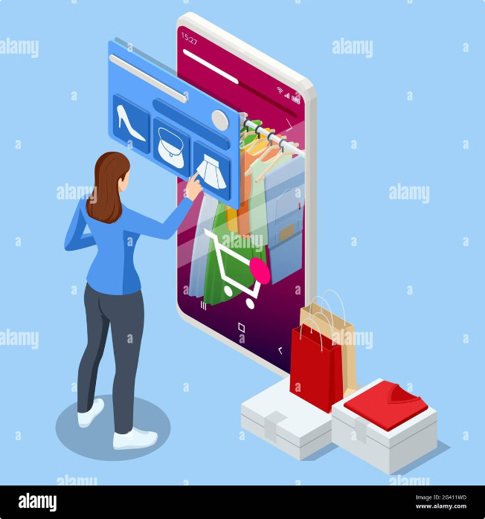
Benefits of Flipkart, Misho, Shopsy, and Montra
Site
Advantages
Flipkart
Wide selection of products, competitive prices, fast delivery.
Misho
Trendy fashion and accessories, exclusive deals, easy returns.
Shopsy
Affordable products, user-friendly interface, secure payments.
Montra
Stylish clothing and footwear, high-quality brands, personalized recommendations.

Slide 8


Conclusion
Online shopping offers convenience, choice, and competitive pricing. By following these tips and using reputable websites, you can enjoy a safe and rewarding online shopping experience.

